Slide 1
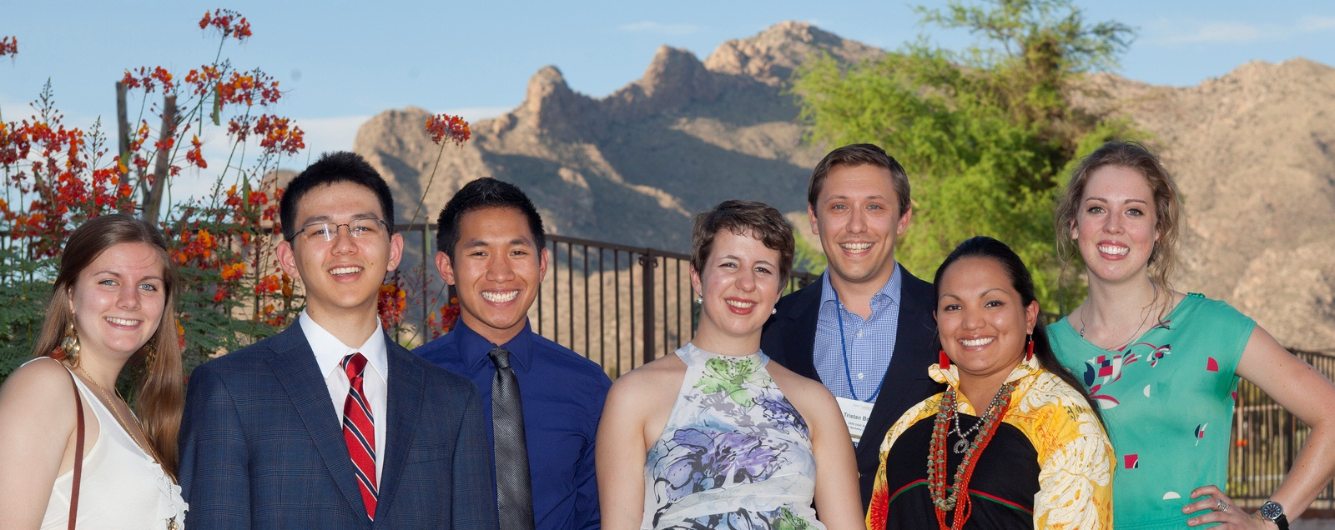

2023 Udall Scholarship Info Session
We’ll Get Started Shortly!

Slide 2
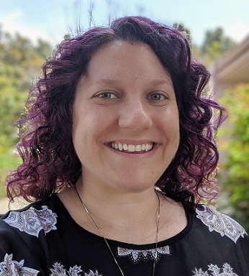
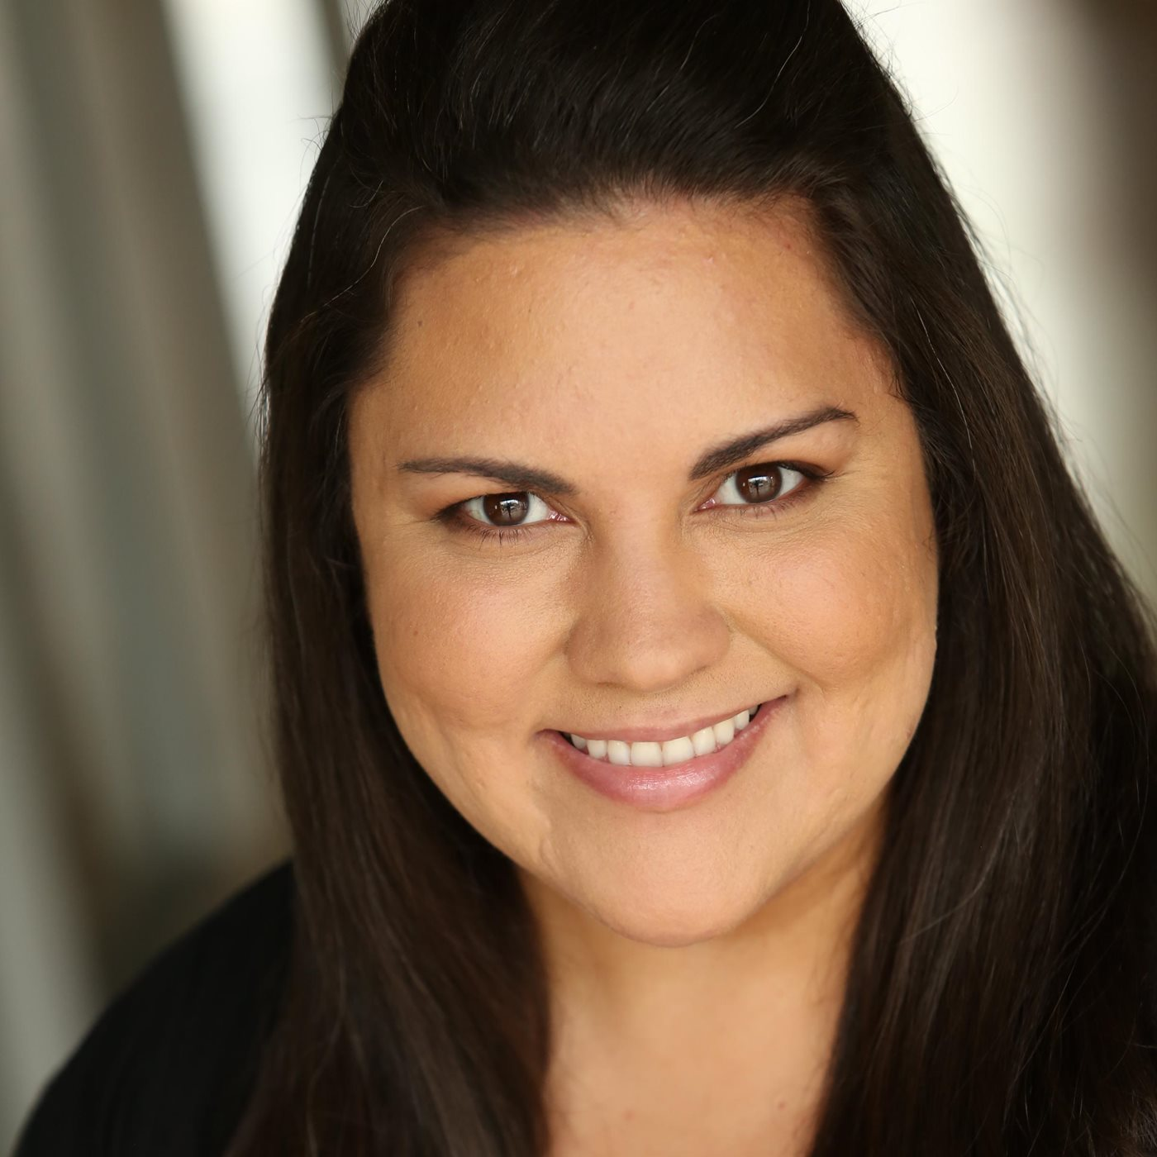

Introductions
Dr. Cassidy Alvarado
Director of ONIF
Name, major, academic year
How have you demonstrated your interest in the environment or in tribal policy/health care?
How do your future goals (academic and/or professional) relate to the environment? OR How do your future goals (academic and/or professional) relate to tribal policy or healthcare?
Lindsay Anderson
Fellowships Advisor
ONIF

Slide 3
What is the Udall foundation?
Established in 1992 as an independent executive branch agency to honor U.S. Representative Morris K. Udall's lasting impact on this nation's environment, public lands, and natural resources, and his support of the rights and self-governance of American Indians and Alaska Natives.
The Udall Foundation awards scholarships, fellowships, and internships for study in fields related to the environment and to American Indians and Alaska Natives in fields related to health care and tribal public policy.
An average of 55 scholarships are awarded each year to current sophomore & junior college students pursuing careers related to the environment, tribal public policy, or Native American health care.

Slide 4
Environment- Who should apply?
Sophomores and juniors who are passionate about using their career to benefit the environment
biology/chemistry
enviro education
enviro economics
natural resources/wildlife mgmt
engineering
journalism/ media
renewable energy
international relations
theater/ music/ visual arts
sustainable development
sustainable textiles and fashion
environmental justice
architecture and design
urban planning
sustainable agriculture
ecology
law and policy
marine science
waste management
… and others!

Slide 5
Tribal Public Policy/Native American Health Care- Who should apply?
Sophomores and juniors who are passionate about using their career to benefit Indian country or their tribe in particular
(just examples, not a complete list)
traditional and modern arts
public health
Indian law
sovereignty and self-determination
gaming
criminal justice
child welfare
sustainable development
elder care
education
economic development
natural resources/wildlife
language preservation
housing
journalism/media
renewable energy
health care
social work

Slide 6
How will the Foundation know I’m Native?
Provide a copy of your citizenship or enrollment verification from your
state- or federally-recognized tribe or band
If you were –ever– enrolled, even if you aren’t now, you are eligible.
OR
Provide a copy of your parent or grandparent’s enrollment verification from a
state- or federally-recognized tribe, and
Copies of birth certificates connecting you to that relative
If your parent or grandparent was –ever– enrolled, even if they aren’t now, you are eligible.

Slide 7
What do you mean by sophomore & junior?
Sophomores have completed 3 semesters of college (outside of high school) by the time March rolls around.
The Foundation doesn’t worry about credits; semesters of experience on campus are important.
Juniors have 2 more semesters to complete after the spring semester in which they apply. (If you have 4 semesters left, you can probably apply as a sophomore)
Selected Scholars must be enrolled full time both semesters of the academic year after winning the award.

Slide 8
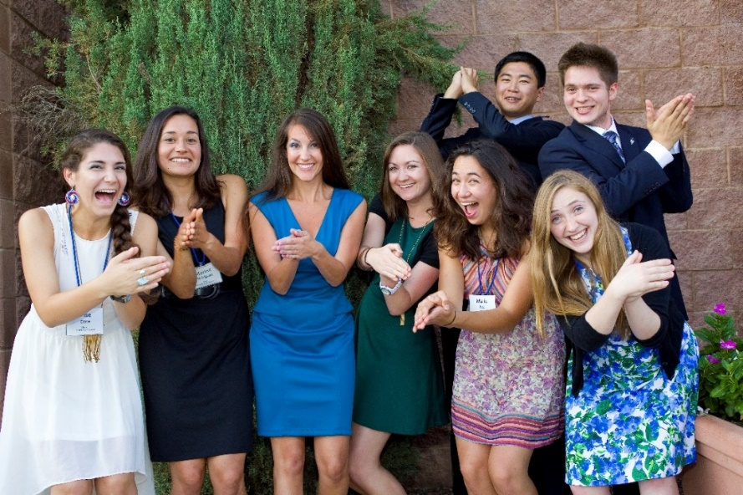
Why should I apply?
Join Udall’s growing alumni network of distinguished leaders.
Meet like-minded students working on important, diverse issues.
$7,000 for study in the
next academic year.
Head start on applying
next year for sophomores
Get a leg up on the other
Udall programs! (Fellowship,
Congressional Internship)

Slide 9
Why should I apply?
Five days in Tucson, Arizona, at Scholar Orientation: extending your professional network, meeting other scholars and alumni, and learning new skills.
  The Scholar Orientation is Required
  2023 Orientation Dates: August 2-6, 2023

Slide 10
Application components
An 12-question application
  6 are short answer essay questions
An 800-word essay/personal statement
Transcripts for all college coursework
  Unofficial is okay, but we have to send official
Three letters of recommendation that speak to your leadership, public service and academic achievements
  Letters must be emailed directly to Lindsay Anderson, LMU's Faculty Representative for Udall

Slide 11
Dust off your resume!
The application will ask you list – in order of descending significance – many of your experiences, such as
  Awards, honors, or scholarships received in past 4 years
  Programs and activities from campus or community
  Internships, assistantships, and jobs in the past 4 years
  Public service and community activities

Slide 12
Short answer essays
What are your professional aspirations? What issues, needs or problems do you hope to address? Indicate in which area(s) of the environment, or tribal public policy, or Native American health care you are considering making your career and specify how your academic program and your overall educational plans will assist you in achieving your goals. (Limit 2000 characters with spaces)
Describe non-course-related research experience, if applicable. Indicate which areas of the environment, or tribal public policy, or health care your research affects, and the ways in which the experience will assist you in achieving your goals. (Limit 1500 characters with spaces)
Describe a leadership experience in which you made a difference on campus or in your community. (Limit 2400 characters with spaces)

Slide 13
Short answer essays
Describe a specific activity or experience that has been important in clarifying or strengthening your commitment to the environment, or tribal public policy, or Native American health care. (Limit 1000 characters with spaces)
Describe briefly your most significant public service, community, or campus activities associated with your interests in the environment, or tribal public policy, or Native American health care, in which you regularly participate. Explain the duration, degree, and significance of your involvement. (Limit 2200 characters with spaces)
What additional information do you wish to share with the Udall Scholarship review committee? (Limit 1100 characters with spaces)

Slide 14
Personal statement
**NEW PROMPT AS OF 2022**
The public service careers of Congressman Morris K. Udall and Secretary of Interior Stewart L. Udall were guided by the core values of civility, integrity, and consensus. In 800 words or less, tell us how these three characteristics resonate with you today and how you exemplify at least one of these values in your personal and professional life.

Slide 15
3 Letters of recommendation
Does not have to be 3 faculty!
  ONIF recommends at least 1 of the 3 is faculty
Briefly explain in what capacity and context they know the candidate
Provide concrete evidence of the candidate's leadership and service activities
Give examples of the candidate's personal characteristics.
What impact have his/her/their actions had?
Letters must be emailed to Lindsay Anderson Lindsay.Anderson@lmu.edu

Slide 16
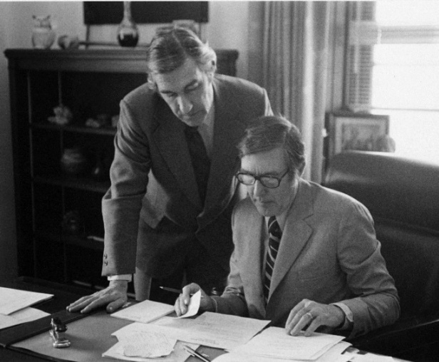

How do I demonstrate commitment to the environment?
Think of ways you’ve led positive solutions to environmental problems and/or Tribal Policy issues
“Crossing the aisle” is a big part of the Udall legacy
Consider how you’ve demonstrated “civility, integrity, and consensus” in your work
  (Pssssst. It’s their motto…)
ONIF can help you fit your experiences into the application!

Slide 17
Some little-known facts
Udall welcomes mature students to apply. There’s no age limit.
GPA is not as important as your leadership, commitment, and public service.
We can nominate up to 4/4 for the national competition
1 Honorable mention last year

Slide 18
Benefits of applying for fellowships
Clarify your academic, professional, and personal goals
Strengthen your writing and critical thinking skills
Develop faculty relationships
Create materials for future applications

Slide 19
Next steps
Begin drafting your application*
  All info session attendees receive a Word copy of the application
  Email Lindsay.Anderson@lmu.edu for FERPA waiver
  Use the Fellowship Support Hub resources on Brightspace
  ONIF is also available to review drafts
Request 3 letters of recommendation
  Schedule meetings to explain why you are applying
  Leadership / Community Service / Academic achievement

Slide 20
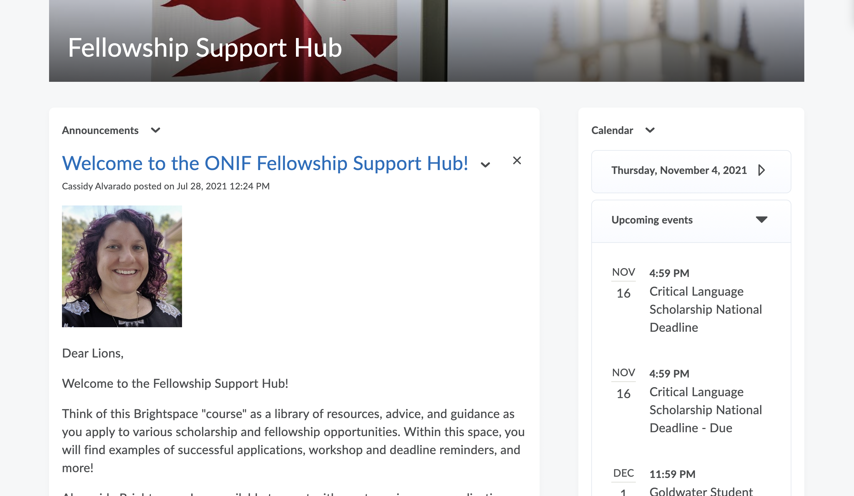

Udall resources

Slide 21
Important dates
January 19: Udall Scholarship Information Session
February 14: Campus Deadline - all application materials must be submitted online and recommenders must email their letters to Lindsay Anderson: Lindsay.Anderson@lmu.edu
  Must complete FERPA release to get access to online application portal
  Campus committee review
March 2: Udall Scholarship national deadline
April 18 and 20: Udall Scholars notified
August 2-6: Udall Scholar Orientation, Tucson, Arizona

Slide 22
Additional resources
The Udall Website!!!
ONIF website
  Fellowship Advisement Appointments
Faculty
Career Professional Development
Writing Center
Penn State's Udall Essay Tips and Samples

Slide 23
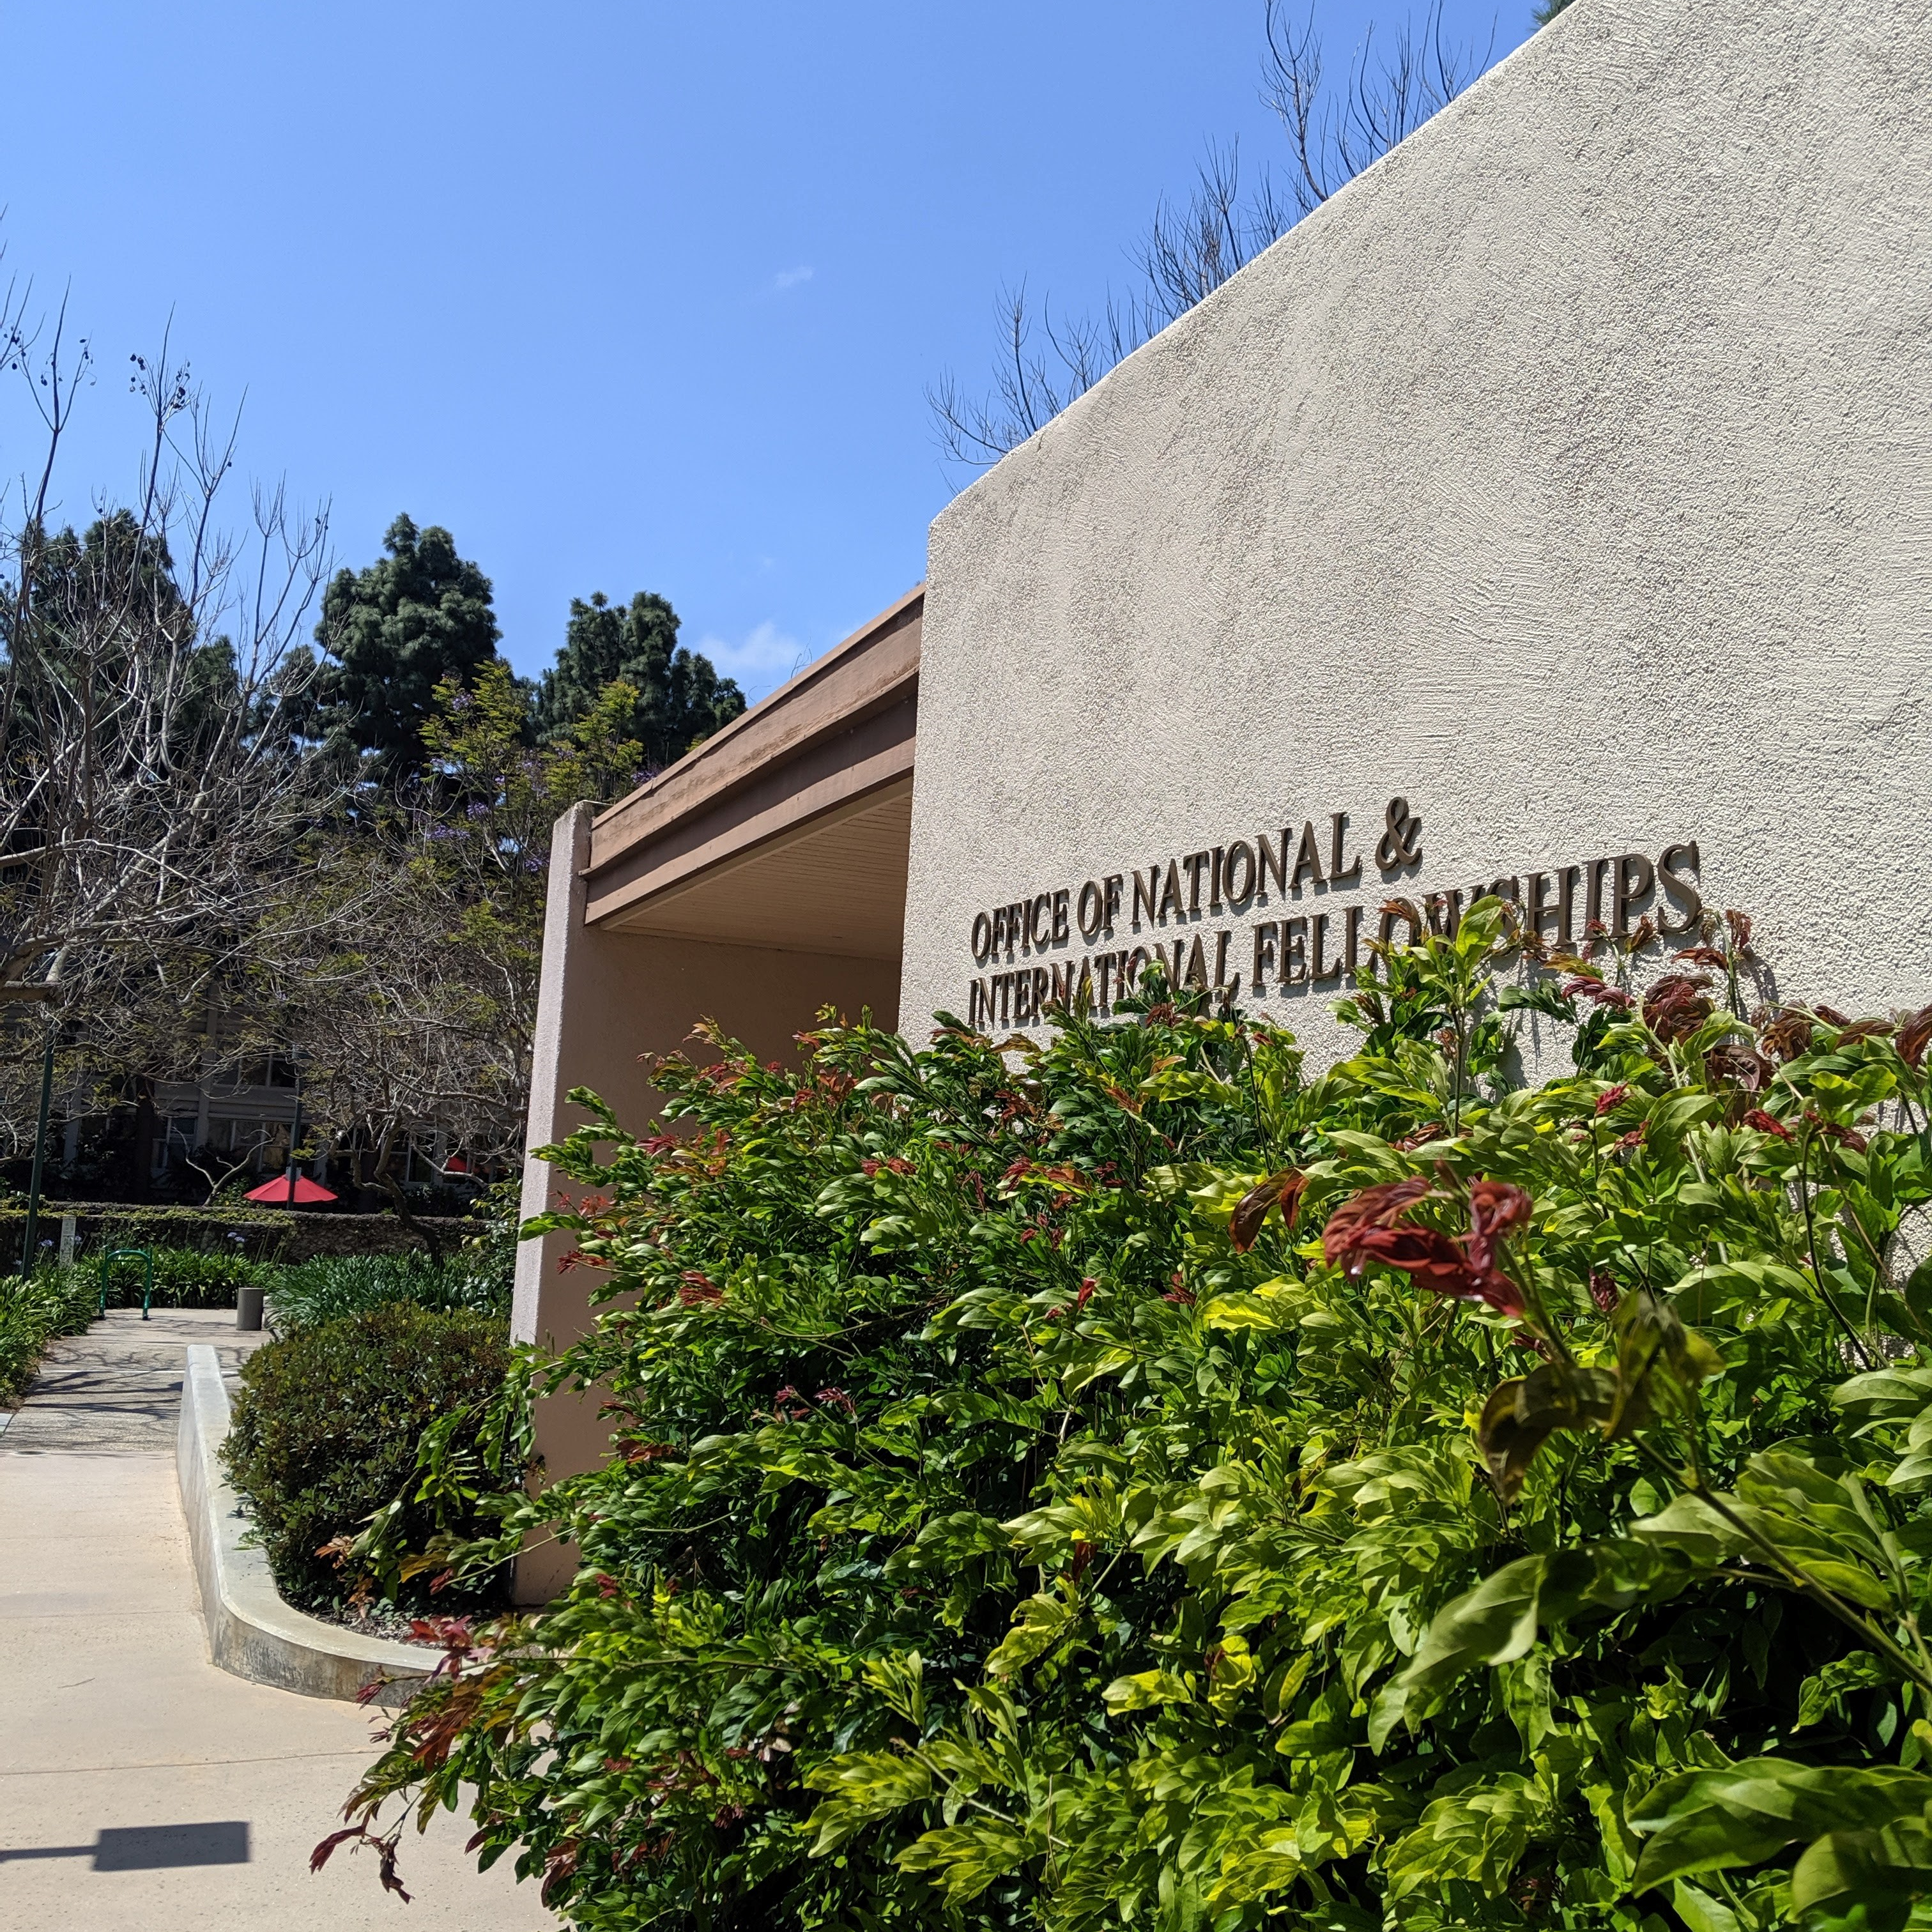
ONIF Services
Fellowship Advisement Appointments
Twice Monthly Funding Friday
Info Sessions & Workshops
General Application Advice
Student Spotlights
Free Thank You Cards
LEO and Social Media
LinkedIn Group: ONIF Connections
Leavey Suite I

Slide 24
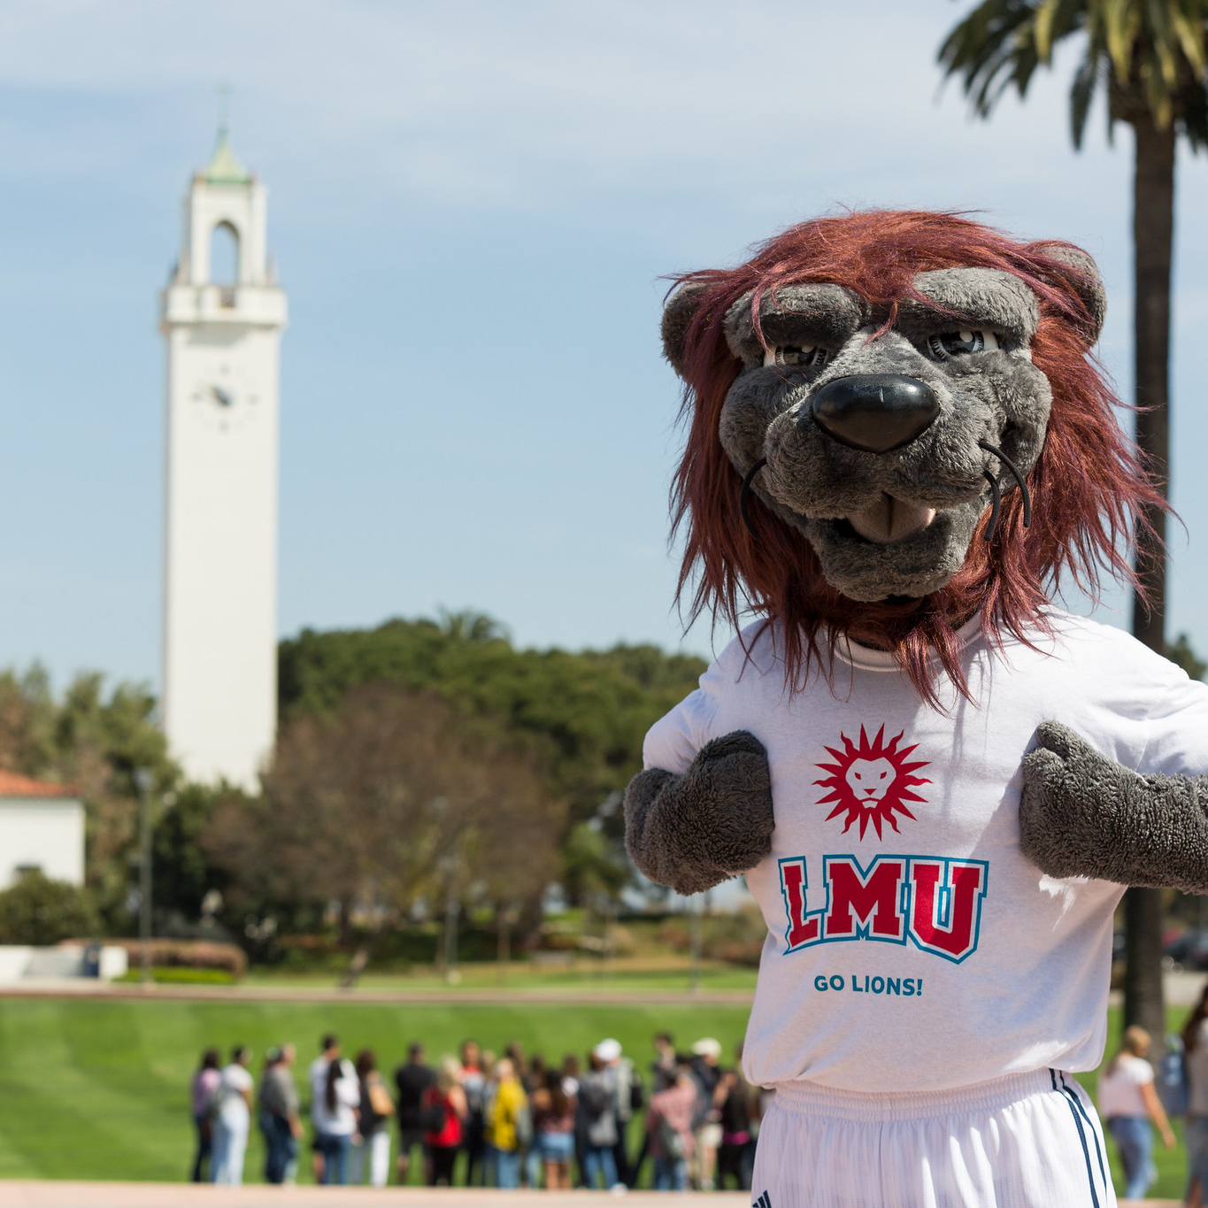




Questions
Loyola Marymount University
Office of National & International Fellowships
Leavey Suite I | 1 LMU Drive | LA, CA 90045
T 310.338.3792 | www.lmu.edu/onif

